Slide 1
To do List
TO DO LIST
TO DO LIST

Slide 2

TO DO LIST
LMS Username | Name | Batch
2113a492 | ABDUL WAHID P | A49
2113a493 | ABIRAMI S | A49
2113a4912 | ANITHRA PRABHA P | A49
2113a4927 | BHARATH KALYAN G | A49

Slide 3

TO DO LIST
Introduction
The To-Do List software is designed to help users organize and manage their daily tasks efficiently. This software will allow users to create, edit, and delete tasks. It will also provide users with the ability to prioritize tasks and set deadlines.

Slide 4
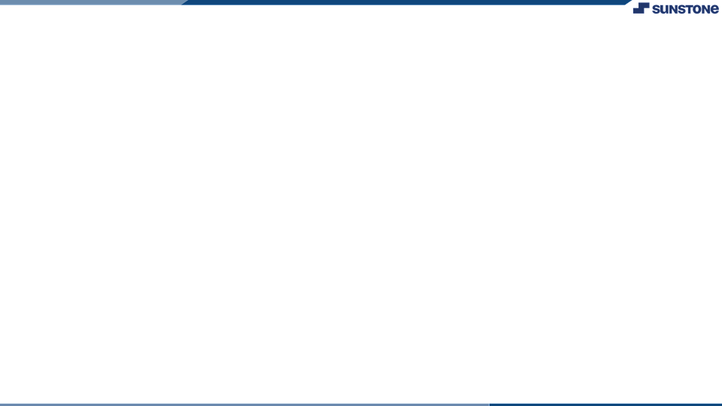

Functional Requirements
User Registration: The software should allow users to register and create an account to access the To-Do List application.
Task Creation: The software should allow users to create new tasks with a title, description, and due date.
Task Modification: The software should allow users to modify the task's title, description, and due date.
Task Deletion: The software should allow users to delete a task.
Task Prioritization: The software should allow users to set the priority of the task.
Task Sorting: The software should allow users to sort tasks by date, priority, and title.
Task Filtering: The software should allow users to filter tasks by completion status, due date, and priority.
Reminders: The software should provide reminders for tasks that are due or overdue.
Task Completion: The software should allow users to mark tasks as completed.

Slide 5

Non-Functional Requirements
Security: The software should ensure that the user's data is secure and protected.
Usability: The software should be easy to use and navigate.
Performance: The software should be fast and responsive.
Compatibility: The software should be compatible with major operating systems and devices.
Accessibility: The software should be accessible to users with disabilities.
Reliability: The software should be reliable and
not crash or lose data.
Maintainability: The software should be easy to maintain and update.

Slide 6

Conclusion
The To-Do List software is designed to help users organize and manage their daily tasks efficiently. The software provides a range of features that will allow users to create, edit, and delete tasks. The software also provides reminders, task prioritization, and sorting to help users manage their tasks effectively. The non-functional requirements ensure that the software is secure, easy to use, and reliable.

Slide 7
Task -1
To Do List
Software Requirement Specification (SRS).
Evaluation Metric:
Project functionality,Software ,Hardware interfaces and user interface System Correctness , Security and Implementation Issues.
Learning outcome
1.Structure and implement HTML/CSS.
2.Apply intermediate and advanced web development practices.
3.Implement basic JavaScript.
4.Create visualizations in accordance with UI/UX theories.
5.Develop a fully functioning website and deploy on a web server.
6.Find and use code packages based on their documentation to produce 7.working results in a project.
8.Create webpages that function using external data.

Slide 8


https://github.com/AbdulWahid002/NM_FULLDSTACKDEVELOPEMENT
Project Link

Slide 9


